Slide 1

TESTING BIG DATA SOLUTIONS FAST AND FURIOUSLY

Slide 2

ABOUT ME
Dmitriy Sobko
Lead QA
Zoral
dmitriy.sobko@gmail.com

Slide 3

AGENDA
Big Data
BI / ETL
DWH
Cloud
Testing concepts
Framework example

Slide 4
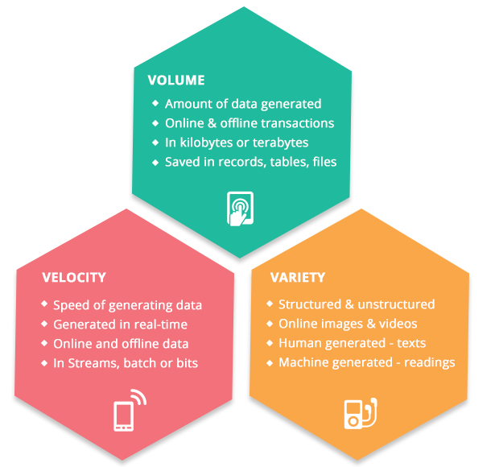
WHAT IS BIG DATA
First, we had data. Now we have big data.
The more data there is, the more you know about things and the sharper your decisions become

Slide 5

BUSINESS INTELLIGENCE (BI)
Know your data to make better decisions
Set of practices, architectures and technologies for gathering, processing and analyzing the data

Slide 6
BI. CLOSER VIEW
Daily transactions and correspondences are recorded
Records are collected in databases
Data are processed and transformed into usable information
Information is analyzed to generate insight

Slide 7

ETL
Extracts data from the multiple and disparate source systems such as records databases
Transforms this data into usable information for decision makers
Loads the data into data warehouses, from which end-users can readily extract usable data for query and analysis

Slide 8
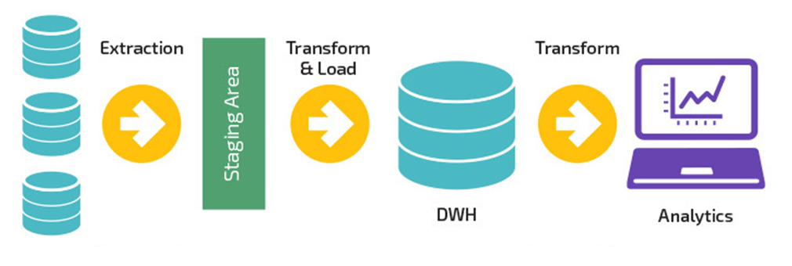

Slide 9
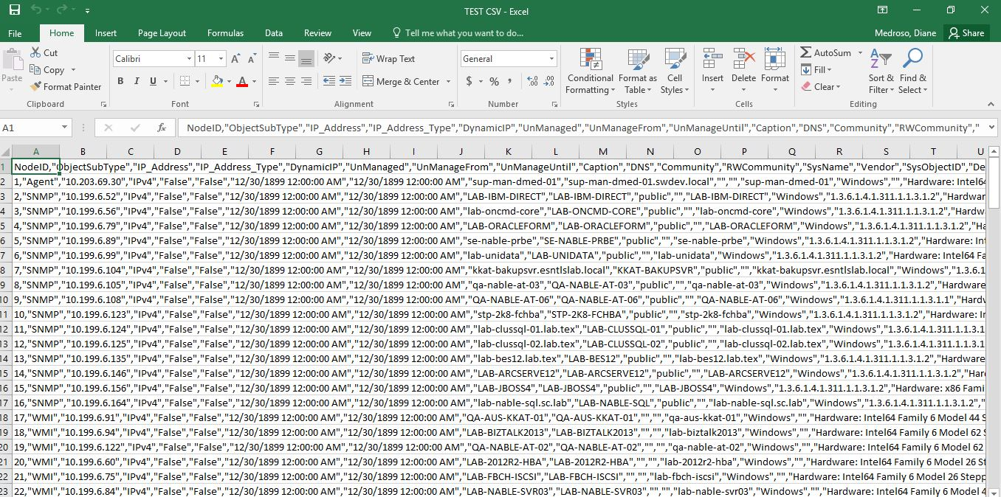
INPUT CSV

Slide 10
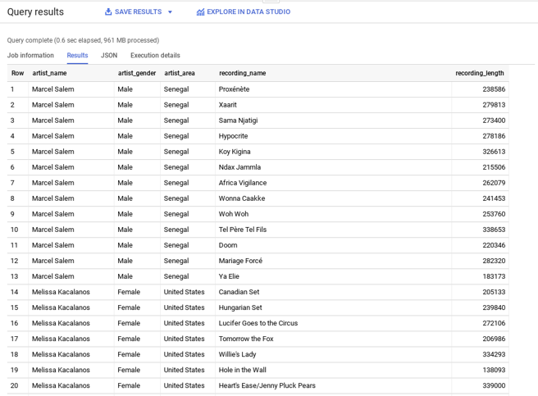
STAGING TABLE

Slide 11
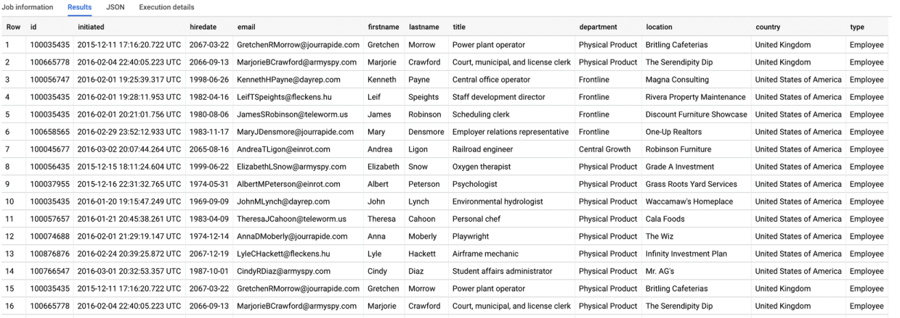
TARGET TABLE

Slide 12
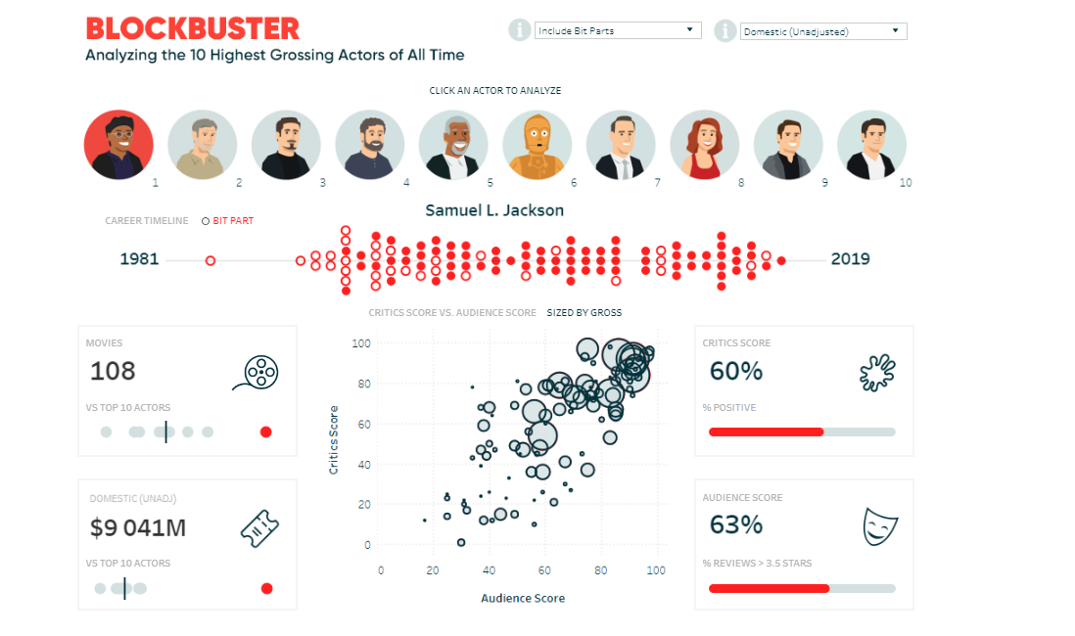
REPORT

Slide 13

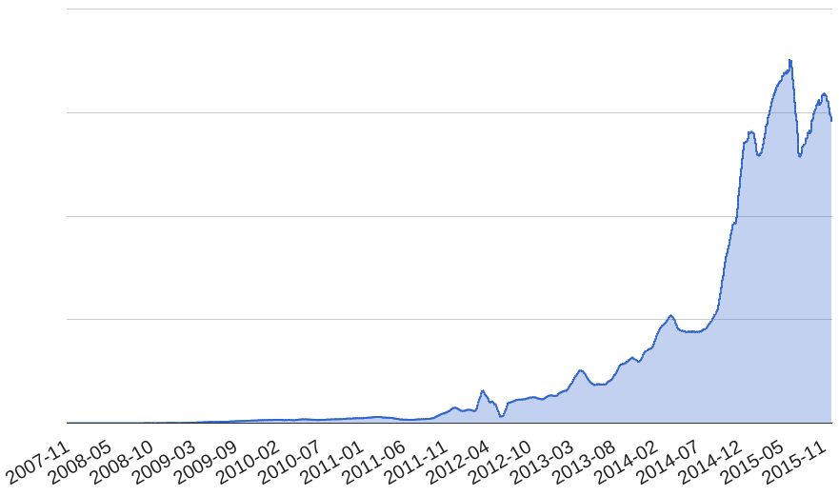
Amount of Spotify’s Delivered Events over time
https://labs.spotify.com/2016/02/25/spotifys-event-delivery-the-road-to-the-cloud-part-i/

Slide 14
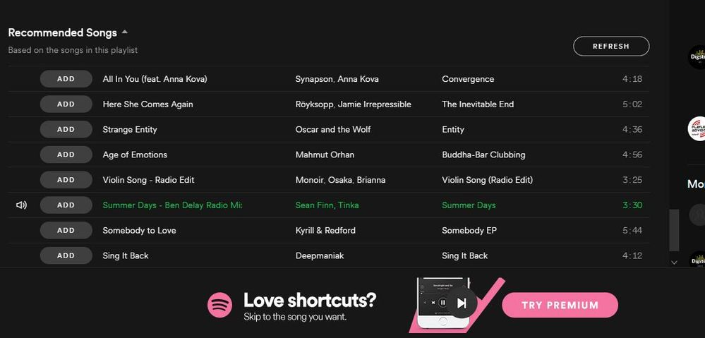

Slide 15

MOVING TO CLOUD

Slide 16


Slide 17
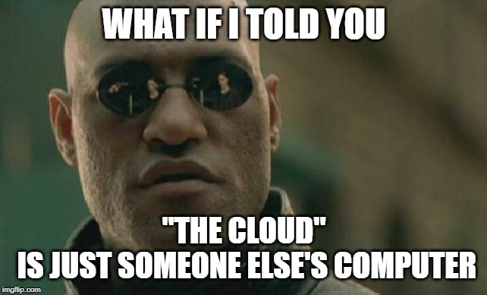

Slide 18
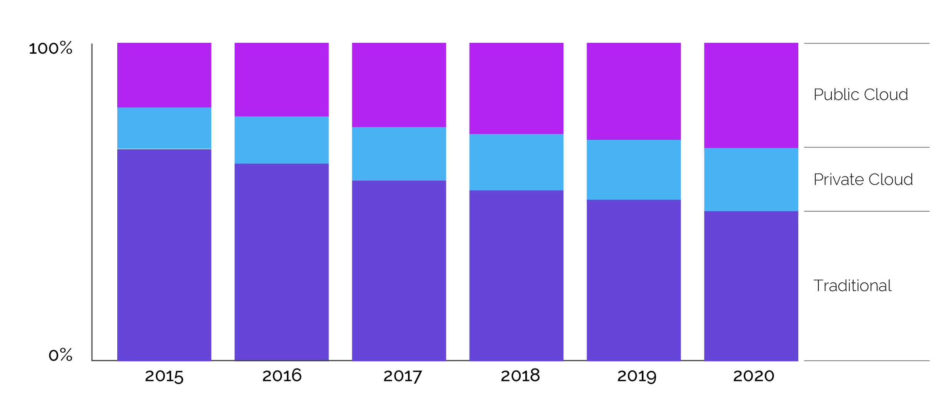
Worldwide Cloud IT Infrastructure Market Forecast
https://www.alooma.com/blog/best-practices-for-migrating-data-from-on-prem-to-cloud

Slide 19


Slide 20
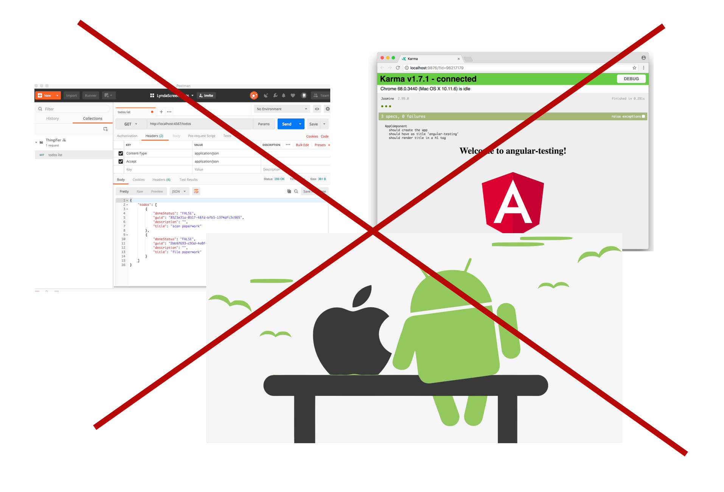

Slide 21
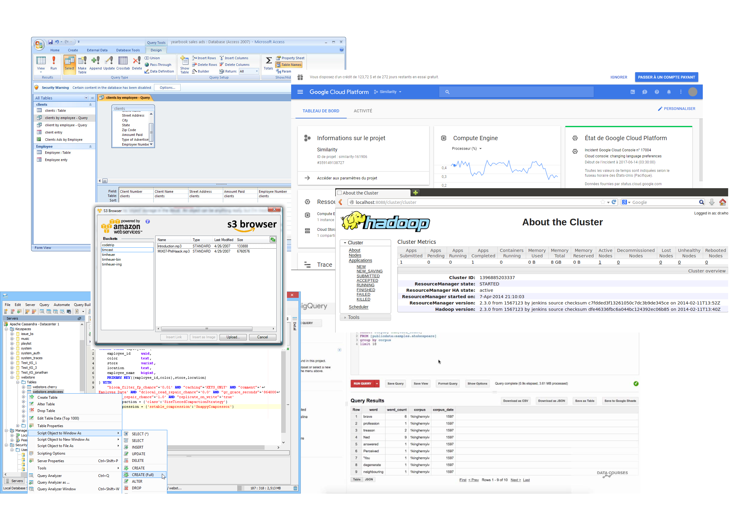

Slide 22
TEST TYPES
Accuracy Testing
Completeness Testing
Data Validation Testing
Metadata Testing
Performance Testing

Slide 23
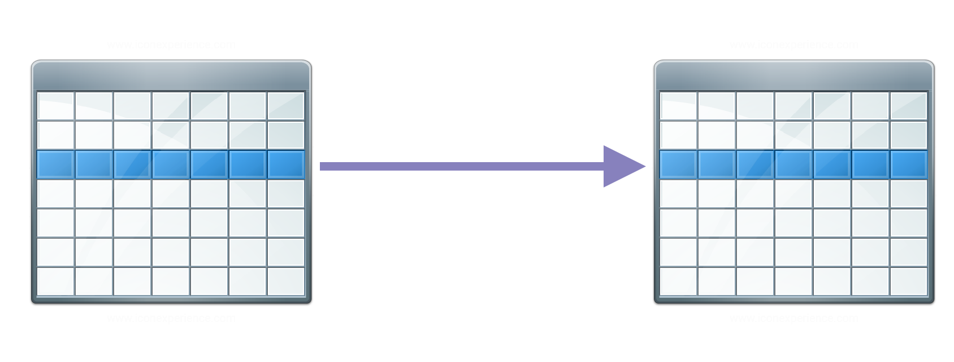
DWH
ACCURACY TESTING
It checks whether the data is accurately transformed and loaded from the source to the data warehouse

Slide 24
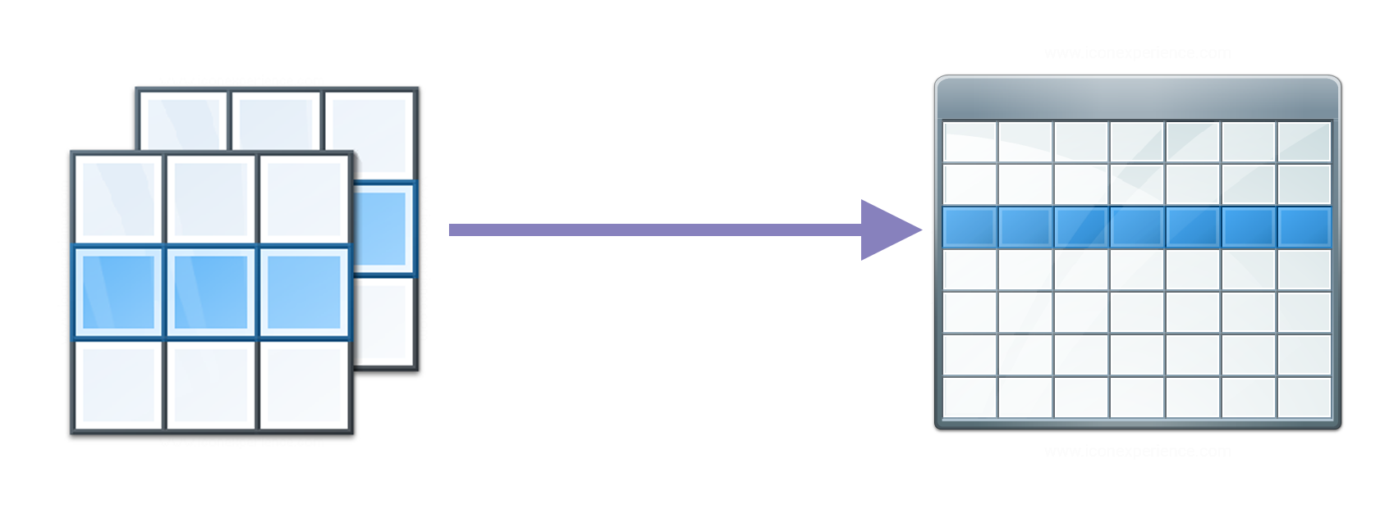
DWH
COMPLETENESS TESTING
This verifies whether all the data from the source are loaded into the data warehouse

Slide 25
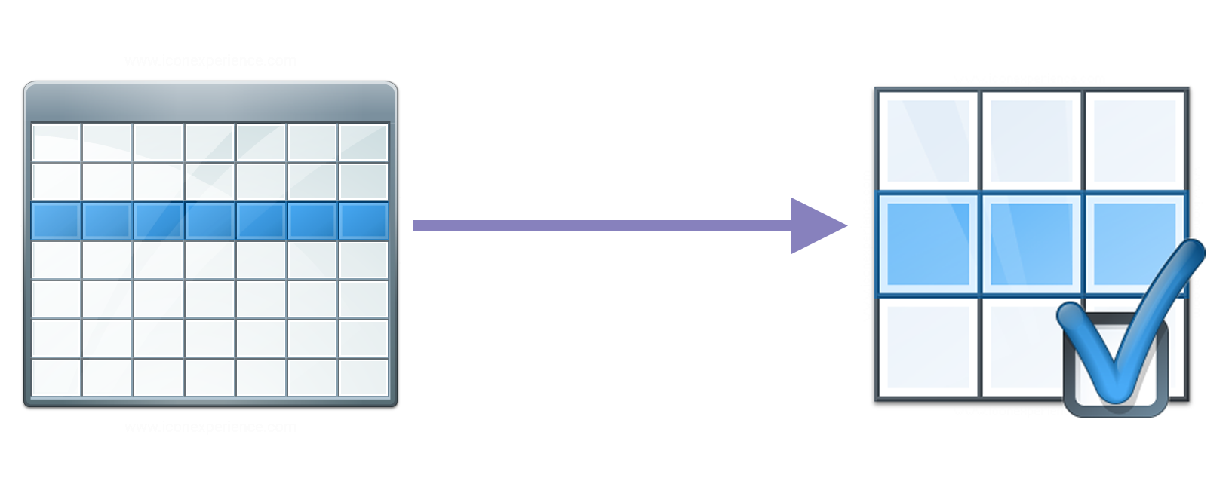
DATA VALIDATION TESTING
This assesses whether the values of the data post-transformation are the same as their expected values with respect to the source values

Slide 26
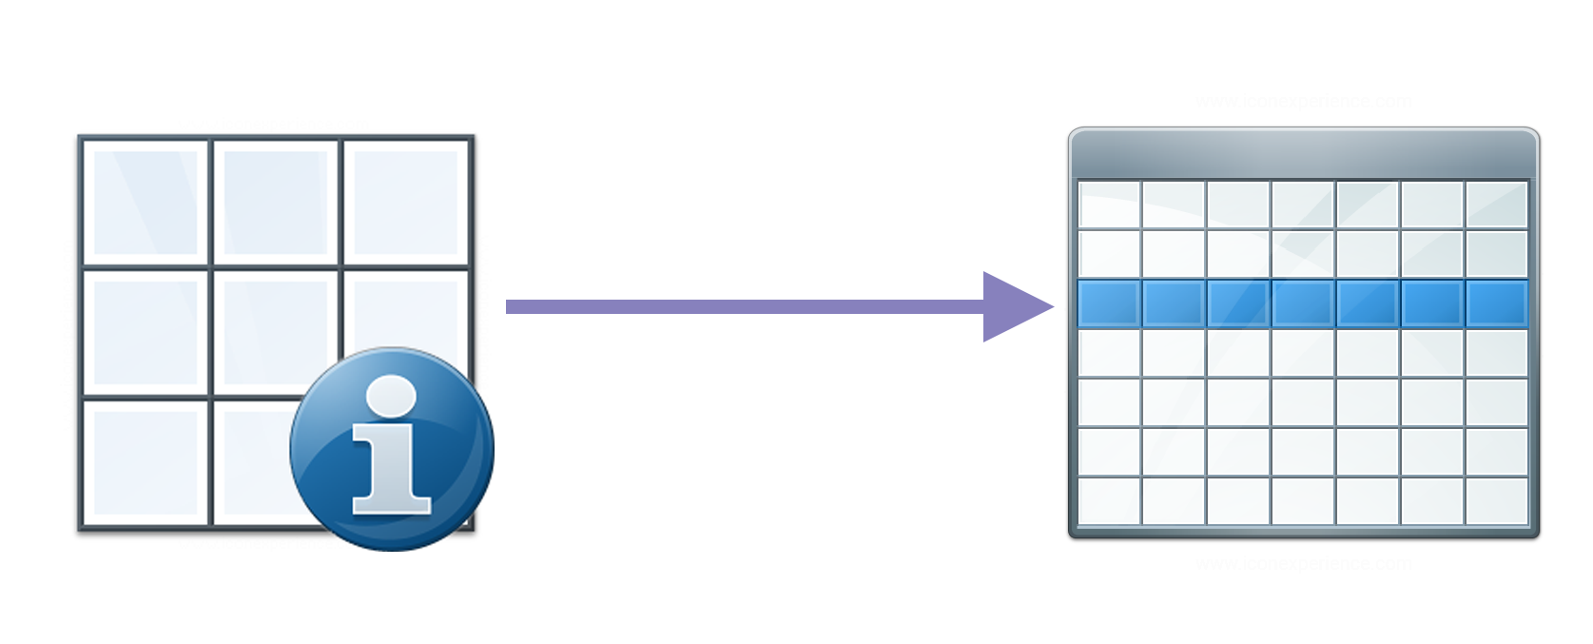
METADATA TESTING
This checks whether data retains its integrity up to the metadata level — that is, its length, indexes, constraints, and type

Slide 27

PERFORMANCE TESTING
How long it takes to process streaming data and batch data
How long reports/datamarts/data feeds are calculated
SLA

Slide 28


Slide 29


Slide 30

TEST APPROACHES
Test on real data
Test code with mocks/stubs

Slide 31

TEST ON REAL DATA

Slide 32
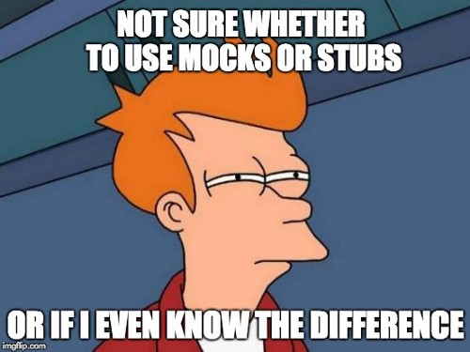
DWH
TEST ON MOCKS/STUBS

Slide 33
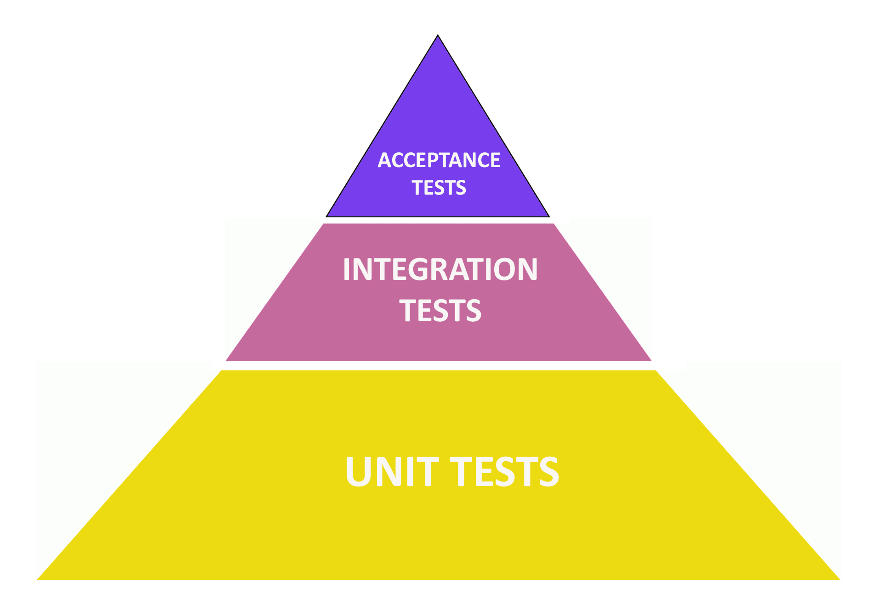
MIXTURE OF BOTH APPROACHES

Slide 34
UNIT TESTS
"WordCount" should "work" in { JobTest[com.spotify.scio.examples.WordCount.type] .args("--input=in.txt", "--output=out.txt") .input(TextIO("in.txt"), inData) .output(TextIO("out.txt")) {
coll => coll should
containInAnyOrder(expected) ()
}
.run()
}
Check that method correctly process input data file

Slide 35
INTEGRATION TESTS
val stream = testStreamOf[GameActionInfo] .advanceWatermarkTo(bTime) // add some elements ahead of the watermark
.addElements( event(blue1, 3, Duration.standardSeconds(3)),
event(blue2, 2, Duration.standardMinutes(1)),
event(red1, 3, Duration.standardSeconds(22)) ) // The watermark advances slightly, but not past the end of the window .advanceWatermarkTo(bTime.plus(Duration.standardMinutes(3)))
Check that method correctly read data from streaming pipeline

Slide 36

ACCEPTANCE TESTS
Make each test self-sufficient and independent
Rely on data contract, not implementation
Assert data as fully as possible

Slide 37

TESTS SHOULD BE
Stable
Resistant to constant
code changes
Fast
Extensible
Easily supported

Slide 38

TECHNOLOGY STACK

Slide 39

KOTLIN
Kotlin is a general purpose, open source, statically typed “pragmatic” programming language for the JVM that combines object-oriented and functional programming features.
It is focused on interoperability, safety, clarity, and tooling support.

Slide 40

SPRING
Spring Boot makes it easy to create stand-alone, production-grade Spring based applications that you can “just run”.
The same for testing frameworks - you can get started with minimum fuss and with very little pre-configuration.

Slide 41

CUCUMBER
Cucumber is a software tool to run automated tests written in a behavior-driven development (BDD) style.
Central to the Cucumber BDD approach is its plain language parser called Gherkin. It allows expected software behaviors to be specified in a logical language that customers can understand.

Slide 42

GRADLE
Gradle is an open-source build automation tool focused on flexibility and performance.
Gradle build scripts are written using a Groovy or Kotlin DSL.

Slide 43

COURGETTE TEST RUNNER
Courgette Test Runner is an extension of Cucumber-JVM with added capabilities to run Cucumber tests in parallel on a feature level or on a scenario level.

Slide 44

CODE

Slide 45
HOW AUTOTEST LOOKS LIKE
Feature: River project test feature
Scenario: Check Alpha feed
Given I check Alpha name field is correct
And I check Alpha views field is correct
And I check Alpha xViews field is correct
And I check Alpha yViews field is correct
And I check Alpha otherViews field is correct
And I check Alpha reportDate field is correct
Scenario: Check Beta feed
Given I check Beta passName field is correct
And I check Beta views field is correct
And I check Beta channelName field is correct
And I check Beta reportDate field is correct

Slide 46
HOW CODE LOOKS LIKE
@Given("^I check Alpha views field is correct$")
fun assertAlphaViewsField() {
service.checkAlphaViewsField()
}
fun checkAlphaViewsField() = execCheckCountQuery(ALPHA_VIEWS_FIELD)

Slide 47
HOW RUNNER LOOKS LIKE
@RunWith(Courgette::class)
@CourgetteOptions(threads = 4,
runLevel = CourgetteRunLevel.FEATURE,
rerunFailedScenarios = false,
cucumberOptions = CucumberOptions(features = arrayOf("resources/features"),
glue = arrayOf("com.dsobko.test"),
tags = arrayOf("@Ready", "~@Bug"),
plugin = arrayOf("pretty", "html:build/cucumber-report")))
object CucumberFeaturesRunner

Slide 48
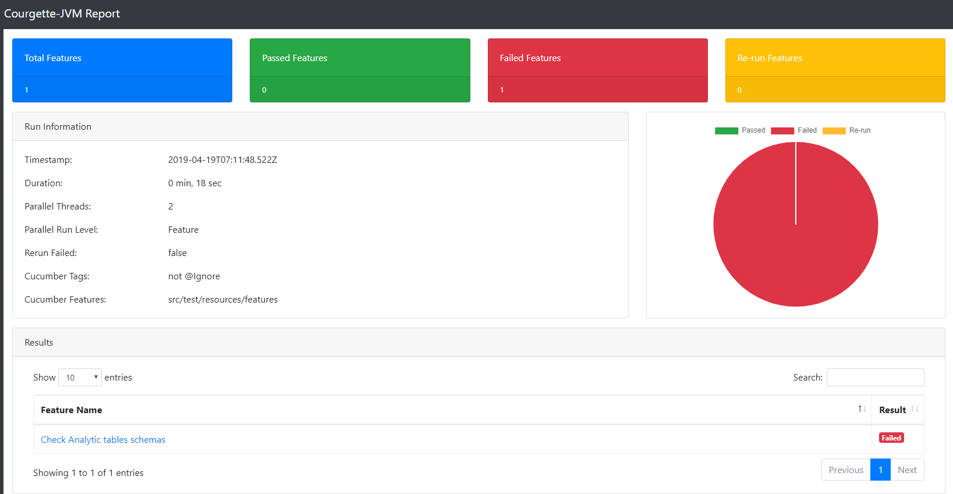
TEST REPORT

Slide 49




ALTERNATIVE SOLUTIONS

Slide 50


Slide 51
LINKS
https://labs.spotify.com/2016/03/10/spotifys-event-delivery-the-road-to-the-cloud-part-iii/
https://kotlinlang.org/
https://spring.io/projects/spring-boot
https://cucumber.io/

Slide 52

THANKS

